Slide 1
2 LAB WORK
Intro to the work

Slide 2
content
SUN PLUM VALUE FORECAST
ObjeCT: TIME SERIES VALUES
GOAL: FORECAST VALUES USING DIFFERENT METHODS
ANALYSIS METHODS:
LINEAR AUTOREGRESSION METHOD
LINEAR NEURON
COMPARATIVE ANALYSIS

Slide 3
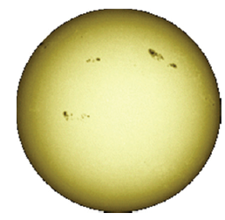
OBSERVATION DATA
1700 5
1701 11
1702 16
1703 23
1704 36
1705 58
... ...
2014 79

Slide 4
LINEAR AUTOREGRESSION MODEL
1700 5
1701 11
1702 16
1703 23
1704 36
1705 58
... ...
2014 79
$$\hat{a}\left(k\right)=w_{1}∙a\left(k−1\right)+w_{2}∙a\left(k−2\right)+…+w_{n}∙a\left(k−n\right)+b$$
36 23 16 5

Slide 5

LINEAR AUTOREGRESSION MODEL
1700 5
1701 11
1702 16
1703 23
1704 36
1705 58
... ...
2014 79
$$\hat{a}\left(k\right)=w_{1}∙a\left(k−1\right)+w_{2}∙a\left(k−2\right)+…+w_{n}∙a\left(k−n\right)+b$$
$$\left.a\left(k\right)=w_{1}∙a\left(k−1\right)+w_{2}∙a\left(k−2\right)+…+w_{n}∙a\left(k−n\right)+b+e(k\right)$$
$$e\left(k\right)=a\left(k\right)−\hat{a}\left(k\right)$$

Slide 6
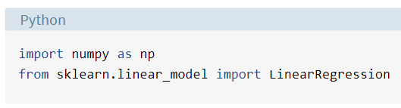
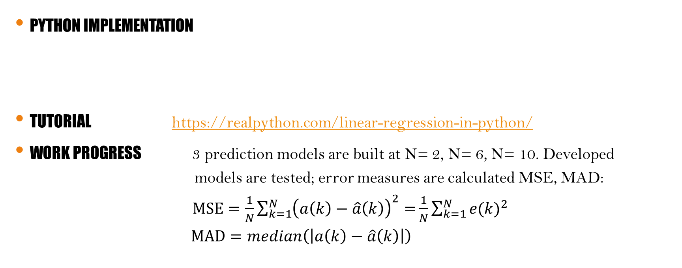
LINEAR AUTOREGRESSION MODEL
Python IMPLEMENTATION
Tutorial https://realpython.com/linear-regression-in-python/
WORK PROGRESS 3 prediction models are built at N= 2, N= 6, N= 10. Developed models are tested; error measures are calculated MSE, MAD: $MSE=\frac{1}{N}\sum_{k=1}^{N}{{\left(a\left(k\right)−\hat{a}\left(k\right)\right)}^{2}=}\frac{1}{N}\sum_{k=1}^{N}{{e(k)}^{2}}$ $MAD=median\left(\left|a\left(k\right)−\hat{a}\left(k\right)\right|\right)$

Slide 7
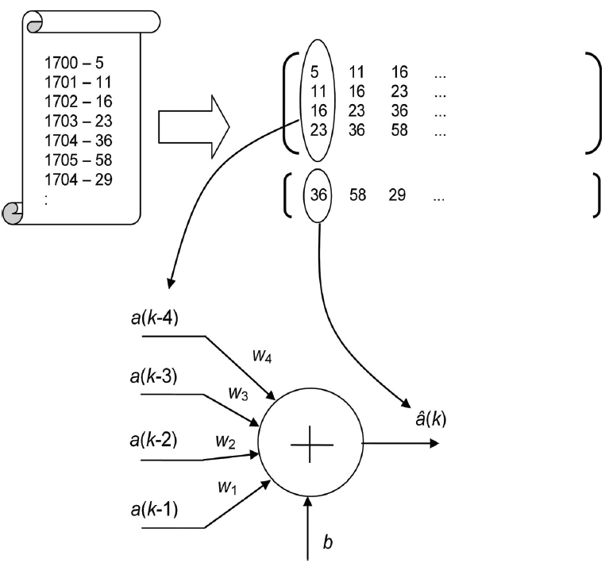
LINEAR AUTOREGRESSION MODEL
Įvesčių matrica P: n eilučių × daug stulpelių
Tutorial: https://www.bogotobogo.com/python/scikit-learn/Single-Layer-Neural-Network-Adaptive-Linear-Neuron.php
Work progress: very small learning rate is a must.
Istoriniai duomenys
Išvesčių matrica T: 1 eilutė × stulpelių kiekis kaip matricoje P

